Slide 1
Basic Goat Health
Dr. Amy Tuominen

Slide 2
Starting off with the right goats !
In order to start off with healthy stock, buy from reputable breeders
There’s no such thing as a free goat!
Things to ask breeders:
Basic husbandry- Do they vaccinate, how are kids processed at birth (do navels get dipped, etc) and do they test for any of the infectious diseases.
Caprine Arthritis Encephalitis (CAE)
Caseous Lymphadenitis (CL)- if vaccinating for CL, likely they’ve had CL in their herd
Johne’s Disease

Slide 3
Visit the herd! You want to be able to see how animals are housed, etc
Check for overall signs of health
Are their hooves in decent condition and not hugely overgrown
Lice! I see lice in probably 80% of the goats I see. I think most herds have it, but they should be dealing with it
Are animals in good body condition score?
Eating well and interacting with other animals normally?
As show animals, it will be easier for you to buy animals that are friendly. So that may be a consideration
Is soremouth an issue? Once you bring soremouth into your herd, it’s almost impossible to get rid of

Slide 4
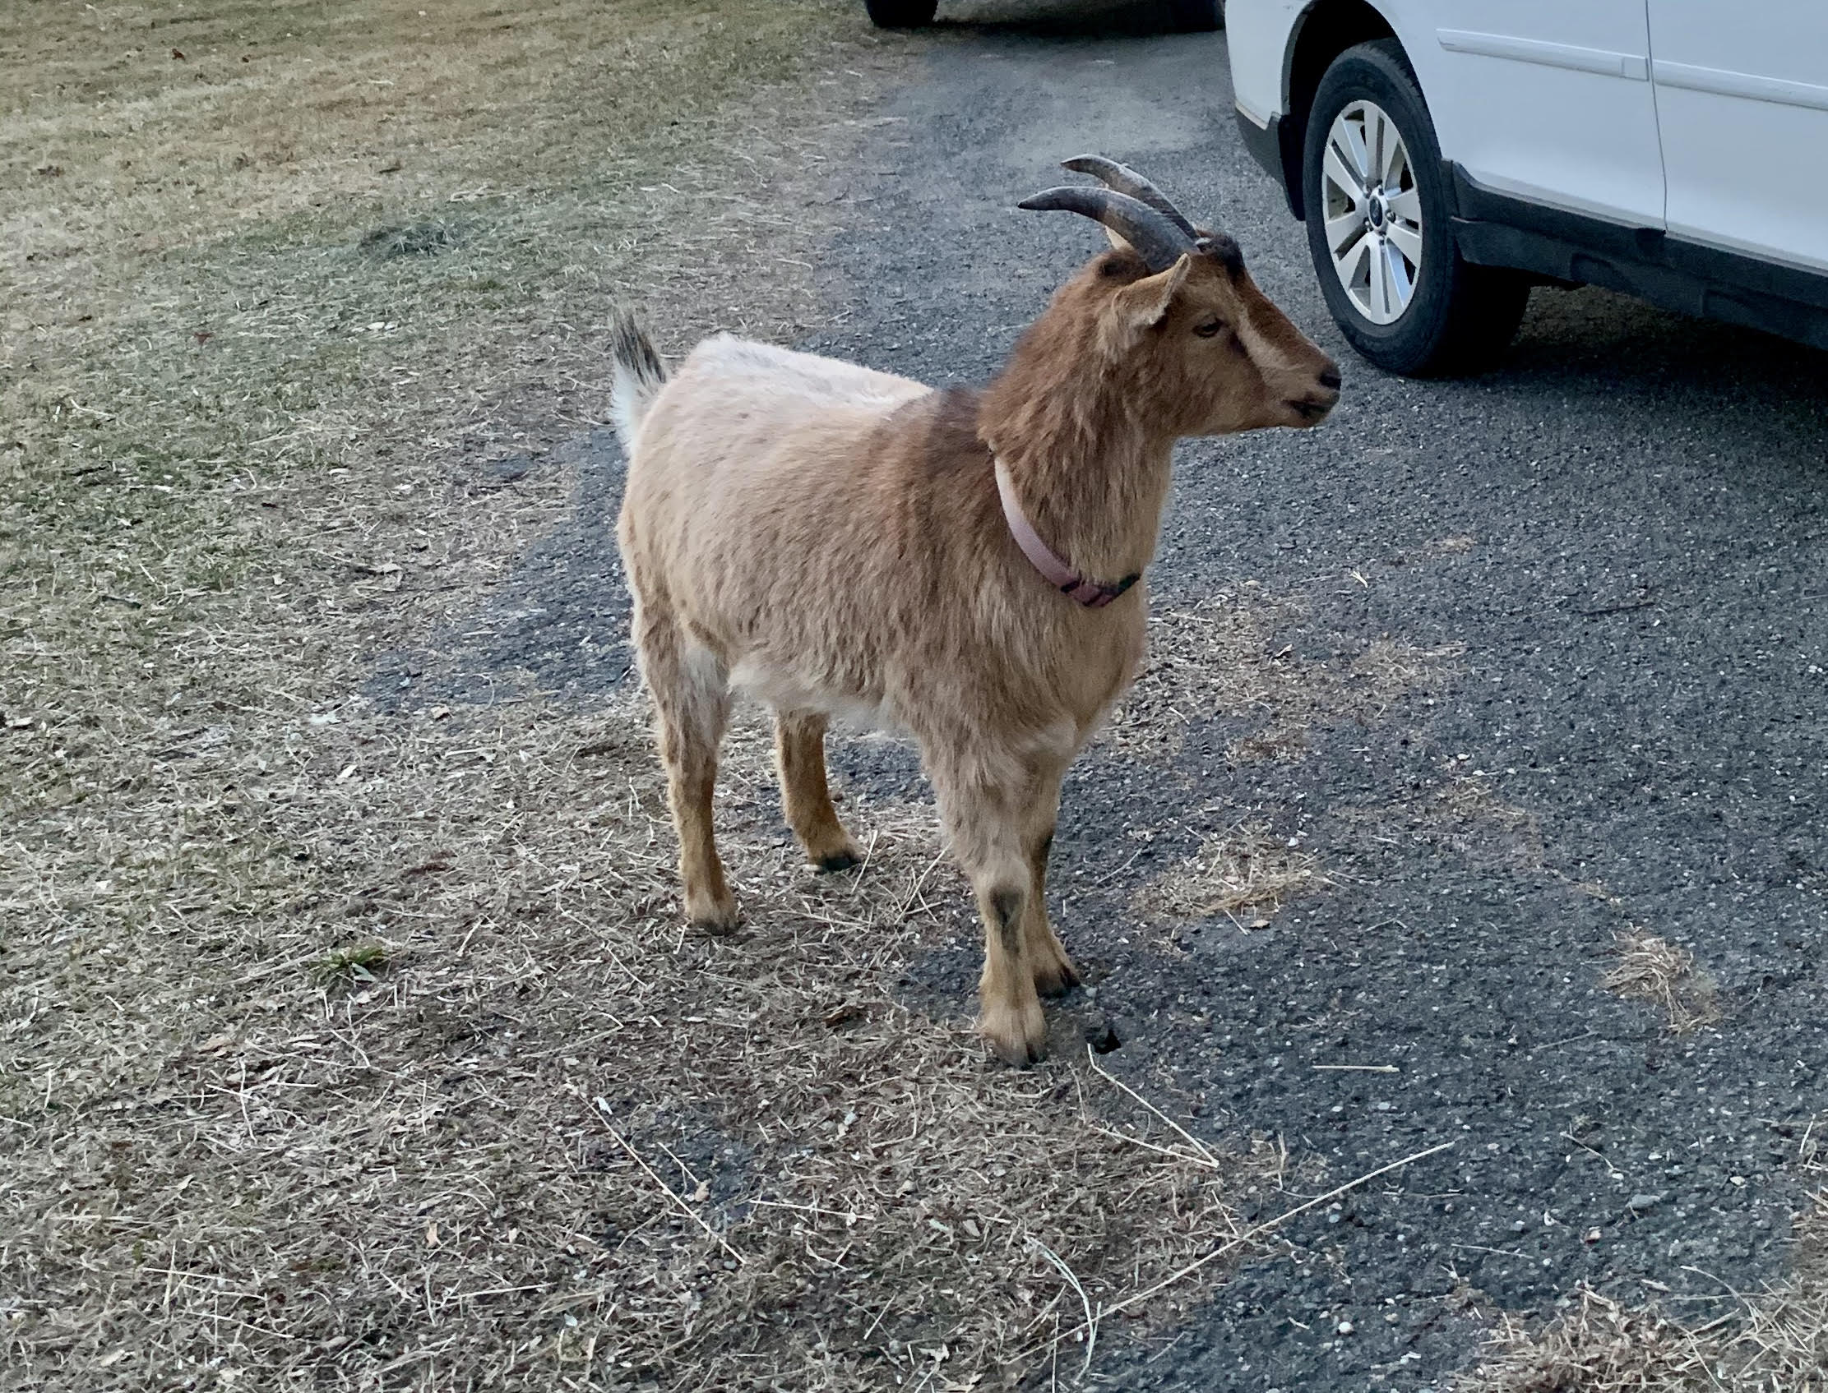
Body Condition scoring

Slide 5
Basic Maintenance
Hoof Trimming- How often depends a bit on your goats. Some need it every 2 months, others can go up to 6 months. If they have cement blocks to play on, will help wear down hoof- less trimming
Vaccines: CD/T (clostridium perfringens and tetanus) at a minimum
Timing- If pregnant does, they should be vaccinated 4-6 weeks before kidding to pass on immunity to kids
Don’t forget to vaccinate bucks as well
Rabies
BCS at least twice a year, more often is better
FAMACHA scoring. Every month is best

Slide 6
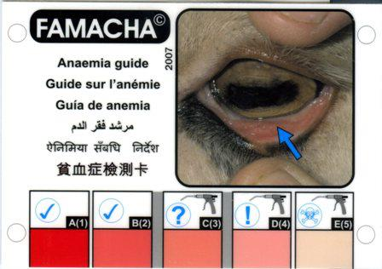
FAMAcha scoring
Should take the class that teaches you the proper way to score.
Want to always use the card
Don’t want to deworm on a regular basis

Slide 7
Disbudding
Should be done at less than 7 days of age. This will result in fewer scurs. Large breeds (Nubians, Alpines, etc) I prefer to do under the age of 4 days
Make sure they are covered with a tetanus vaccine
Pain management
Discuss with your vet if you’re doing it yourself
I disbud all kids under sedation and they get a local anesthetic and pain medication

Slide 9
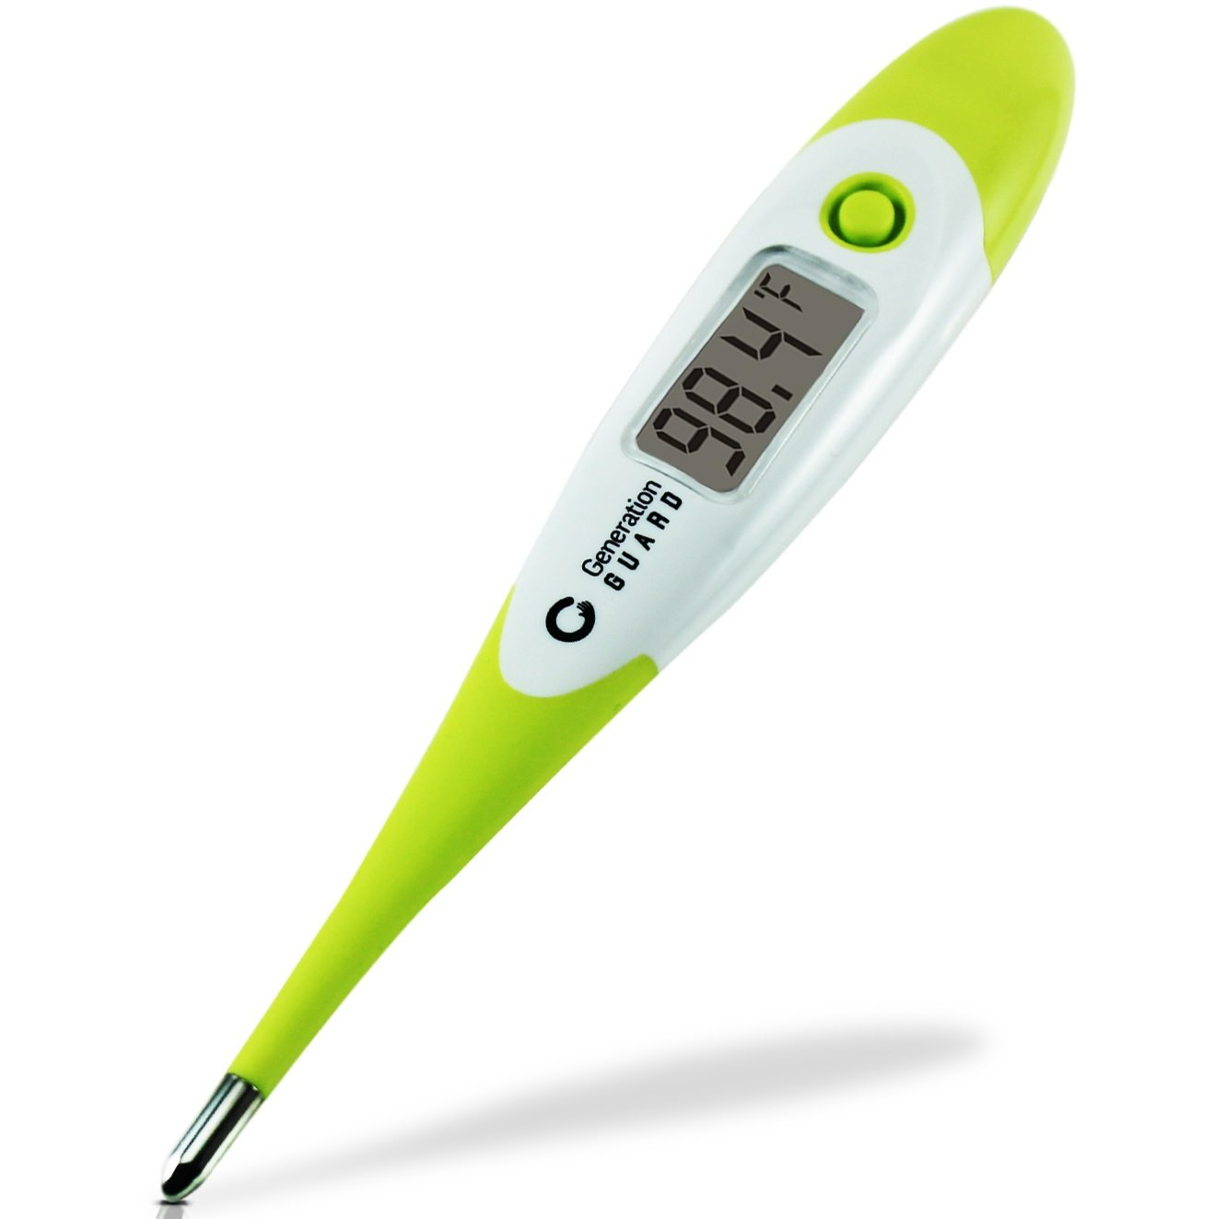
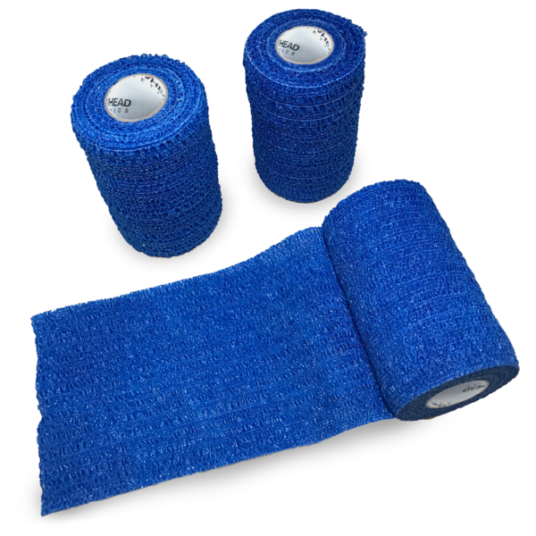
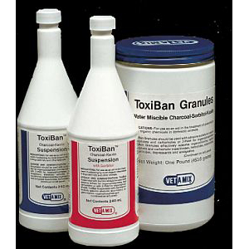
First Aid Kit
Thermometer!
Bandage Material- Gauze, Roll cotton, vet wrap
Betadine
Alu-spray/alushield. Not Blu-Kote! Not legal for use in food animals.
OB lube
Syringes/needles
Therabloat/Bloat release
Activated Charcoal

Slide 10
First aid kit continued
Veterinary Prescription medications
Thiamine
Banamine
Some type of antibiotic
Should have a relationship with a veterinarian. Don’t wait until you have an emergency to call!

Slide 11
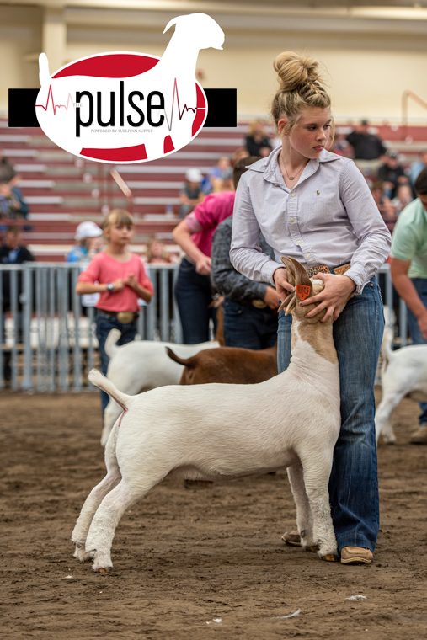
Show kits
Travel with your first aid kit!
In addition to the things in your first aid kit, add in a bottle of B Complex and probiotics.
Animals get stressed at shows, so those are good to have on hand
Have your vet’s number handy so you can call with any concerns

Slide 12
Common problems
Intestinal
Monitor Famacha and BCS
Weight loss! Can be other causes of weight loss but always keep intestinal parasites in mind
Call a vet if concerned
Good to perform fecal egg counts regularly
Routine deworming isn’t recommended: resistance

Slide 13
External parasites
Goats acting itchy
Hair loss
Flaky skin sometimes
Lice are big enough to see
In severe cases, can get anemia, especially when young kids affected
Treatments based on what type of parasite. Most commonly I see lice. Topical pour on such as UltraBoss
UltraBoss can also be used to help deter ticks

Slide 14
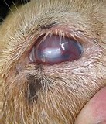
Pinkeye
Caused by a bacteria that flies spread
Flies will be attracted more to runny eyes
Signs include a red eye, teary eye, acting painful especially in sunlight, and ulcers
Fly control is huge for prevention!
Treatment: Oxytetracycline. Consult with your vet. Especially since other things can cause eye to look like pinkeye, such as foreign bodies or other injuries

Slide 15
Respiratory diseases
Numerous causes: both viral and bacterial
Can be contagious or environmental
Symptoms: Coughing, nasal discharge, lethargic, breathing fast, fever
Treatment: Antibiotics and anti-inflammatories
Prevention: Good biosecurity, especially when showing, housing management and can use vaccine: inforce 3 in at-risk animals

Slide 16
Urethral obstruction/urinary calculi
This is an emergency! Especially if not urinating at all
Major cause is Diet!
Signs: Straining, often people think they’re constipated
Lying down on side and straining, kicking at abdomen
Treatment:
If still dribbling urine, can give ammonium chloride. Will not work on all types of stones
Surgery
Euthanasia
The longer it goes on without treatment, the more likely euthanasia is!

Slide 17
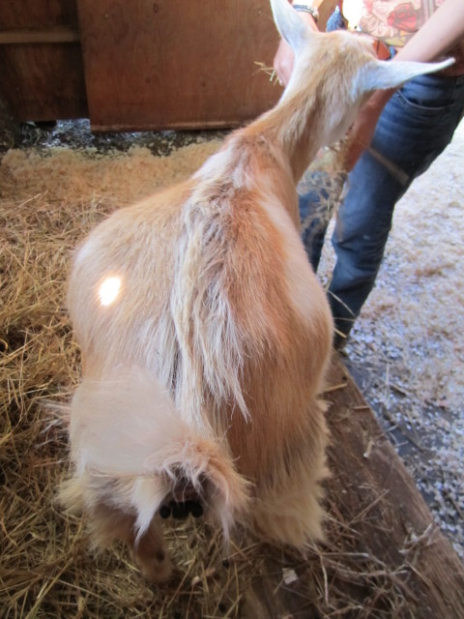
Bloat
Also an Emergency! Call your vet!
Causes include over-eating, getting cast in an upside position, choking on something
Symptoms:
Abdominal distention
Vocalizing
Diarrhea

Slide 18
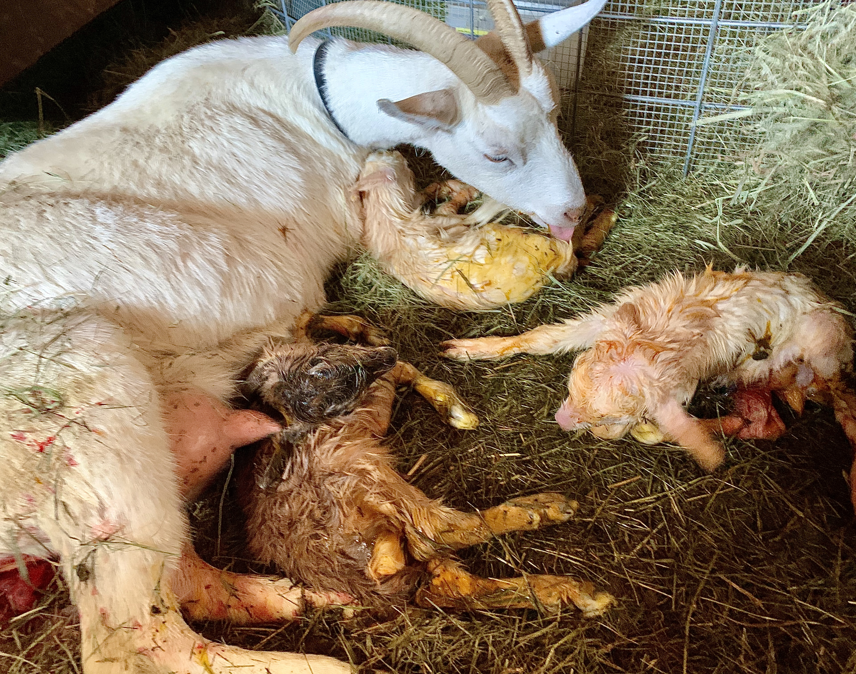
Pregnancy toxemia
Usually late term does, typically carrying multiples
Due to lack of nutrition. Need more concentrate in late pregnancy. Can’t physically eat enough hay to meet needs due to size of uterus
Symptoms: Lethargic, off feed, off from rest of herd, grinding teeth, lying down, coma
Treatment: Requires intensive Veterinary care
Poor prognosis unless caught in the early stages.

Slide 19
Dystocia
Difficulty kidding
Signs: active straining with no progress for 30 min
Call your vet!
If you’re comfortable with basic dystocia’s, you can wash up the doe and your arms, and using some OB lube, reach in to take a feel. If you’re not sure what’s going on, call the vet

Slide 20
CAE
One of the things we test for
Caprine Arthritis Encephalitis
Spread via milk and colostrum
Signs can include arthritis, pneumonia, mastitis, chronic weight loss and encephalitis (kids)
There is no treatment. Only supportive care
No vaccine, test all new animals
If positives in herd, ideal to cull. If not, should remove kids at birth

Slide 21
Toxic Plants

Slide 22
Main ones in this area are Mountain Laurels, Rhododendrons and Azaleas.
Other toxic plants include milkweed and Oldeander
Symptoms of mountain laurel/rhododendron toxicity include lethargy, vomiting, grinding teeth, painful abdomen
Call your vet
Dose dependent. If ate a lot, death is possible.
Activated charcoal can be administered as soon as you realize they ate it

Slide 23
Biosecurity
Always important! Especially if showing animals
Quarantine new arrivals and any animals that have been to a show. Minimum of 2 weeks
Wash all show equipment thoroughly
Don’t allow unnecessary visitors onto the farm. Have a foot bath out for visitors prior to entering goat area
Want to prevent bringing diseases home

Slide 24
Questions?

